Slide 1

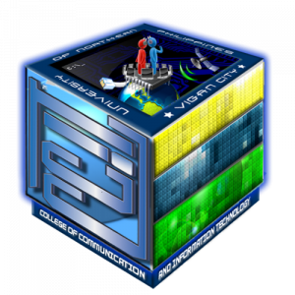
UNIVERSITY OF NORTHERN PHILIPPINES
College of Communication and Information Technology
Final Defense Presentation
Researchers: Rualizo, Cain P.
Arruejo, Jan Paolo P.
Belarde, Kobe Byein D.
Duldulao, Sherlyn G.
BS INFOTECH 4D
Capstone Adviser:
RICHARD C. ARRUEJO, DIT

Slide 2
ArtBid: Digital and Handmade Artwork Online Auction System for Artist Students

Slide 3
CONTENTS:
Introduction
Statement of Objectives
Significance of the Study
Scope and Delimitations
Methodology
Results and Discussion
System Presention

Slide 4
Introduction
An online auction is an auction which is held over the internet. It is a popular method for buying and selling products and services. The proposed system helps the customer sell and buy products at the best price. Virtual auctions facilitate online activities between buyers and sellers in different locations.

Slide 5
The Digital and Handmade Artwork Online Auction System, located at University of Northern Philippines, This study conducted to design and develop a web-based Digital and Handmade Artwork Online Auction System for Artist Students. The developed system is expected to solve and lessen the problems encountered in the process of Online Auction.

Slide 6
II. Statement of Objectives
This study aimed to design and develop digital and handmade artwork online auction system for artist students where student who has talent on making digital and handmade
Specifically, it aims to meet the following objectives:
Determine the problems encountered in the online auction system in terms of:
Failure to deliver; and,
Misrepresentation;

Slide 7
II. Statement of Objectives
Develop the Digital and Handmade Artwork Auction for Artist Students of the College of Fine Arts and Design at the University of Northern Philippines;
Develop the Digital and Handmade Artwork Auction for Artist Students using the Agile model.

Slide 8
II. Statement of Objectives
4. Determine the level of usability of the proposed appointment system using ISO 25010 software quality evaluation tool along:
Functional Suitability
Performance Efficiency
Reliability
Security

Slide 9
III. Significance of the Study
The Digital and Handmade Artwork Online Auction System will be beneficial for the following:
Online Auction
Bidder
Auctioneer
Seller
Researchers
Future Researchers

Slide 10
IV. Scope and Delimitation
Scope
This study aims to develop an online auction system for Digital and Handmade Art. This system only accepts sellers located within the University of Northern Philippines. Registered potential buyers and sellers participate in either auction process. Bidders will be able to get connected to the specific sellers who will offer them the necessary information and give a hand to sell their items to them. It will help save time and offer quality deliverables to the bidders through quick response and attentive service. This system will replace the manual way of seeking items in the market and traveling along journeys just to get an item yet there are available items just in around the school.

Slide 11
IV. Scope and Delimitation
Delimitation
The system is exclusively for the College of Fine Arts and Design at the University of Northern Philippines. The system does cater to online auction systems. The system is available online, it can run on the window operating system and automatically back up and restore data and it cannot be used without an internet connection.

Slide 12
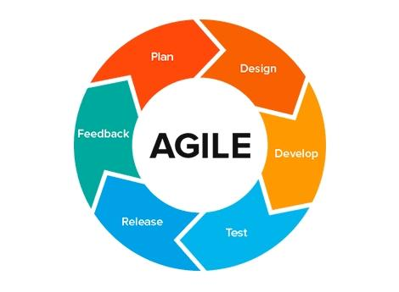
V. Methodology
AGILE METHODOLOGY

Slide 13
V. Methodology
Requirements Planning
In this phase, the researchers did a brainstorming and discussion about the proposed Digital and Handmade Artwork Online Auction System for Artist Students, after which, they assigned tasks and assignments to every member of the group. During this stage, developers, clients (software users), and team members communicate to determine the goals and expectations for the project as well as current and potential issues that would need to be addressed during the build.
The researchers conducted an interview with the student and IT specialist of the seller and bidder on the problem in the online auction procedures, process, and operations. Sample forms were also gathered by the researchers.

Slide 14
V. Methodology
User Design
In this phase, once the project is scoped out, it is time to develop building out the user design through plan, design, develop, test, release and feedback.. The programmer designs the user and bidder to test it, and then they come together to communicate what worked and what did not. The next step is they test the efficiency and productivity of the system, after that the proponents tested the input and output functionality of the system to determine if the system worked according to its purpose. Testing will be done with the admin, seller, and bidder of the online auction required to involve in the testing phase so that they can correct any defect, test and rate their information phases on the system the system provides.

Slide 15
The last part of the user design is to release. Once the user evaluates the plan and if they are unsatisfied, the current plan is refined concurring with the requirements. A new plan is developed the additional information will be provided to the user. The process will continue until all the requirements specified to the user are met. If the user is satisfied with the developed plan, the final system is developed on the final plan. The researchers keep developing the system needs and suggestions of the seller and bidder to make the system they want and need.

Slide 16
V. Methodology
Construction
This phase takes the prototypes of systems from the design stage and converts them into the working model. The majority of the problems and changes were addressed during the thorough iterative design phase, developers can construct the final working model more quickly than they could by following the project management approach. This phase includes the program and application development, coding unit, integration, and system testing. The database and programming languages used are HTML, CSS, JAVASCRIPT, PHP, and SQL. HTML is used for describing the structure of Web pages, CSS is used for describing the presentation of Web pages, including colors, layout, and fonts, JAVASCRIPT allows to add dynamic behavior to the webpage and add special effects to the webpage, PHP is used to develop dynamic and interactive web pages and SQL is used to communicate with and manipulate databases.

Slide 17
V. Methodology
Cutover
This phase discusses the database and programming language used in the implementation phase, this is the implementation phase where the finished project goes to launch. It includes information conversion, testing, and changeover to the modern system. All final changes are made while the coders and clients proceed to search for bugs within the system. It conclude the functionality of the system was well done and did testing again and changeover to the new system for verification of the owner if she is willing to take over or use this system for the online auction.

Slide 18
VI. Results and Discussion (Findings)
1. The problems encountered in the manual appointment system.
The researchers were able to develop a Digital and Handmade Online Auction System for Artists Students have come up with the following findings:
The researcher has encountered problems with the online auction payment.
Due to time constraints and a lack of technical knowledge, we could not develop an administrative section of the online auction website and an online payment system could not be achieved. However, the team is still researching how to add all those features for user satisfaction.

Slide 19
VI. Results and Discussion (Findings)
2. The functional requirements of the system.
The developed automated system includes the functional requirements of the system were determine through analysis of the gathered data during the interview. The following are the functional requirements of the system: Login, Register, Adding Artwork, Bidding session, Inform the winners and losers, and Payment/Transaction.

Slide 20
VI. Results and Discussion (Findings)
3. The developed Digital and Handmade Artwork Online Auction System for Artist Students using the Agile Scrum process model.
The researchers used the Agile Scrum software process model in developing the automated system. The system was developed by the researchers by following the phase of Agile Scrum Methodology Model: requirements gathering, user design (plan, design, develop, test, release, and feedback), construction, and cutover.

Slide 21
4. Evaluation of Digital and Handmade Artwork Online Auction System for Artist Students using the ISO 25010 along the criteria Functional Suitability, Performance Efficiency, Reliability, and Security.
Using ISO 25010, the researchers were able to determine the quality of the proposed system in terms of the criteria of Functional Suitability, Performance Efficiency, Reliability, and Security. The Digital and Handmade Artwork Online Auction System for Artist Students was evaluated by the students of College of Fine Arts and teacher’s and the defense committee members. The proposed system was evaluated in four criteria namely: Functional Suitability, Performance Efficiency, Reliability, and Security.

Slide 22
VI. Results and Discussion (Conclusions)
Based on the findings of the developed system, the following conclusions were drawn:
1. The problems encountered in the online auction system of Digital and Handmade Artwork will be addressed through the implementation of the developed system.
2. The functional requirements integrated into the online auction system met the expectation and needs of the digital and handmade artwork.

Slide 23
3. The Agile Scrum Development software process model is efficient for developing the system. It ensures the development of high-quality products faster by following its phases.
4. The developed system is functional, efficient, reliable, and secured as indicated by the grand mean of 4.44 and interpreted “Highly Usable”.

Slide 24
VI. Results and Discussion (Recommendations)
The researchers recommend the implementation of Digital and Handmade Artwork Online Auction System for Artist Students.

Slide 25
VI. Results and Discussion (Recommendations)
Therefore, we recommend that the administrative section of this work be looked at by interested researchers who have an interest in the field of study. Also, a payment system that will allow users to pay money online for their goods to be delivered to them could be enhanced.

Slide 26
System Presentation

Slide 27
Bidder

Slide 28
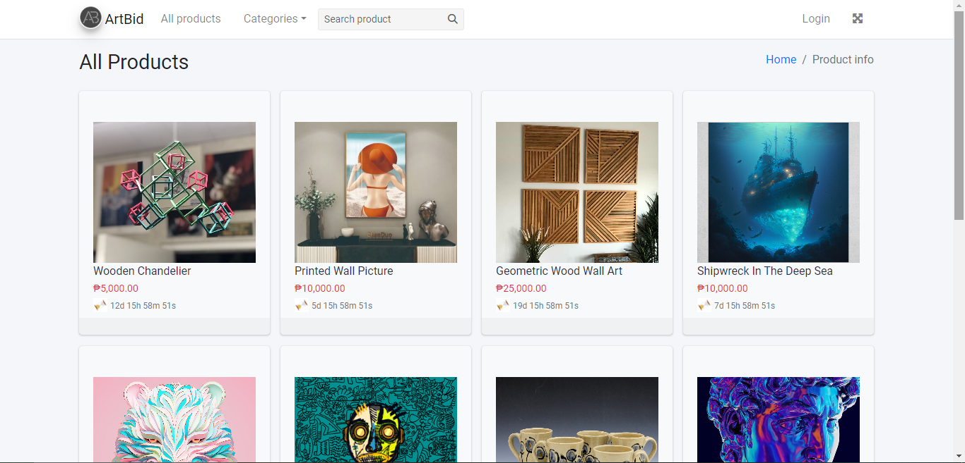
Homepage of the system

Slide 29
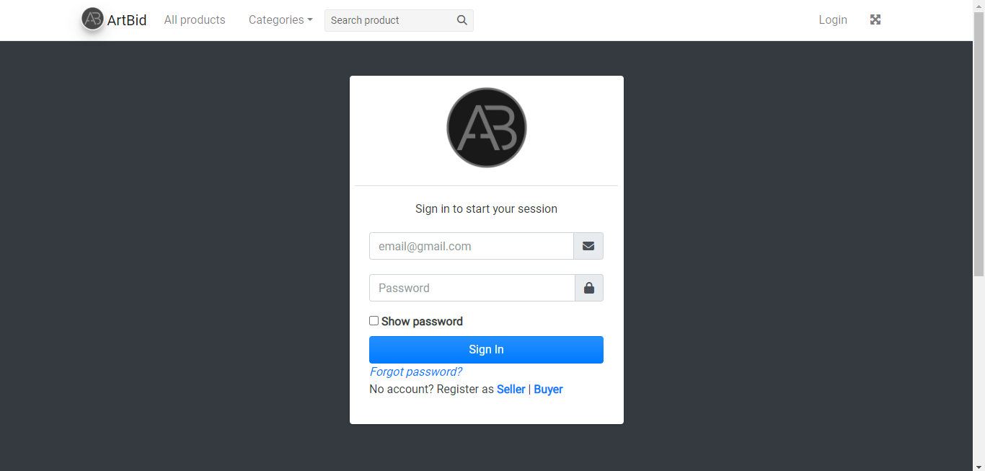
Login page of the system

Slide 30
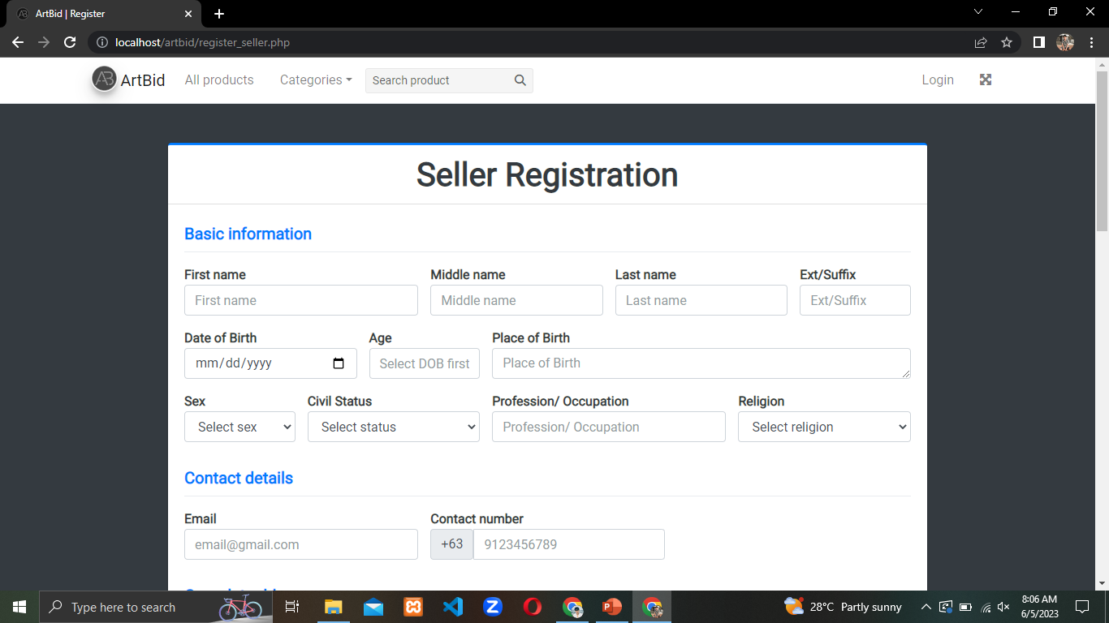
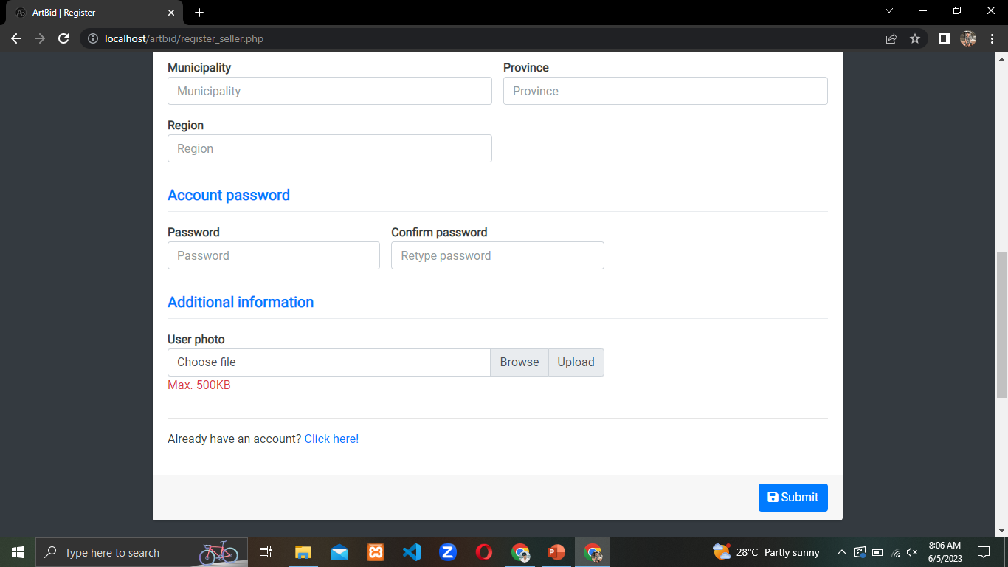
registration page of the system

Slide 31
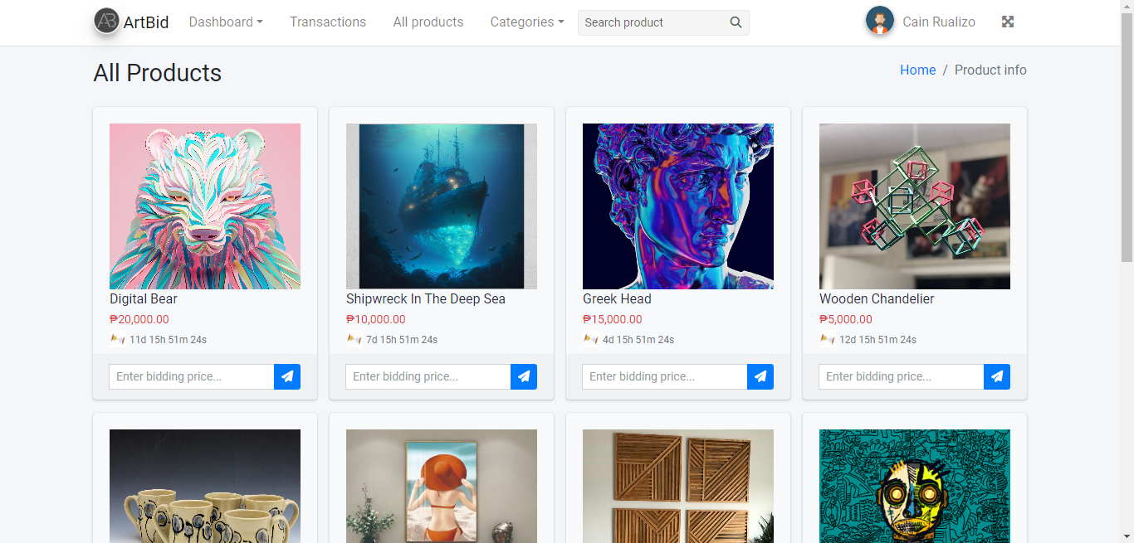
Once user login they can start bid for arts

Slide 32
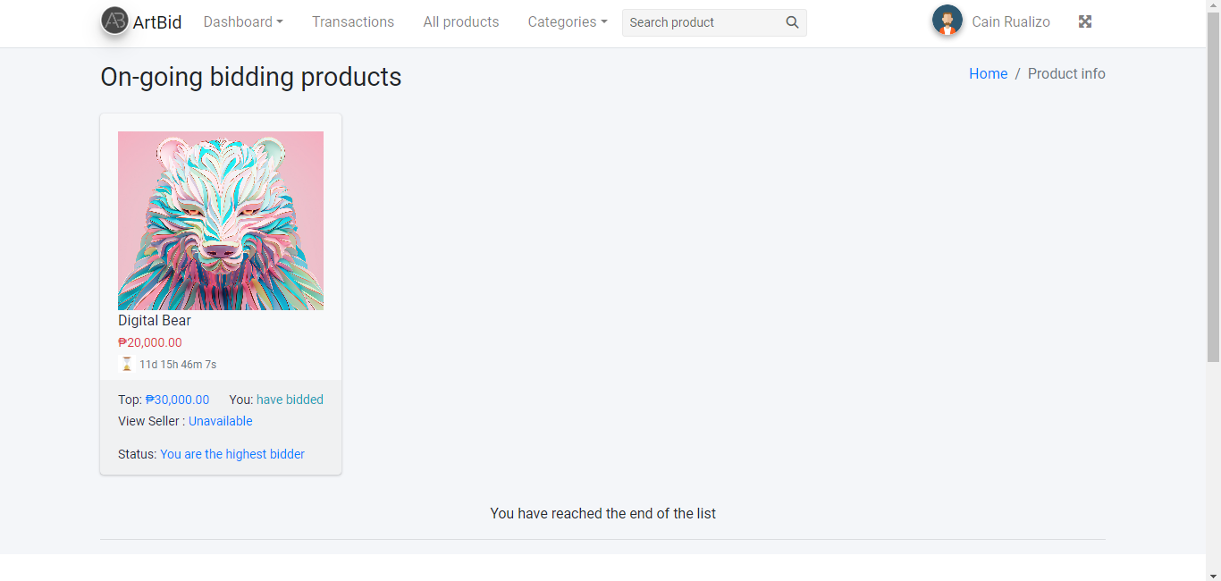
Once you bid on an item you can see the product in the dashboard/ongoing bidding

Slide 33
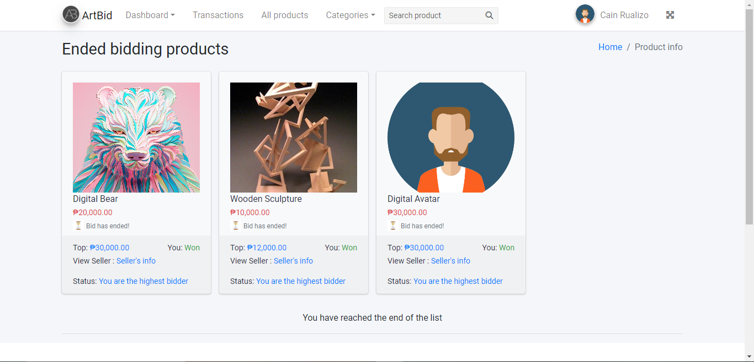
If the bidding ends, the bid item will go to the dashboard/ended bidding to see if you win/lose.

Slide 34

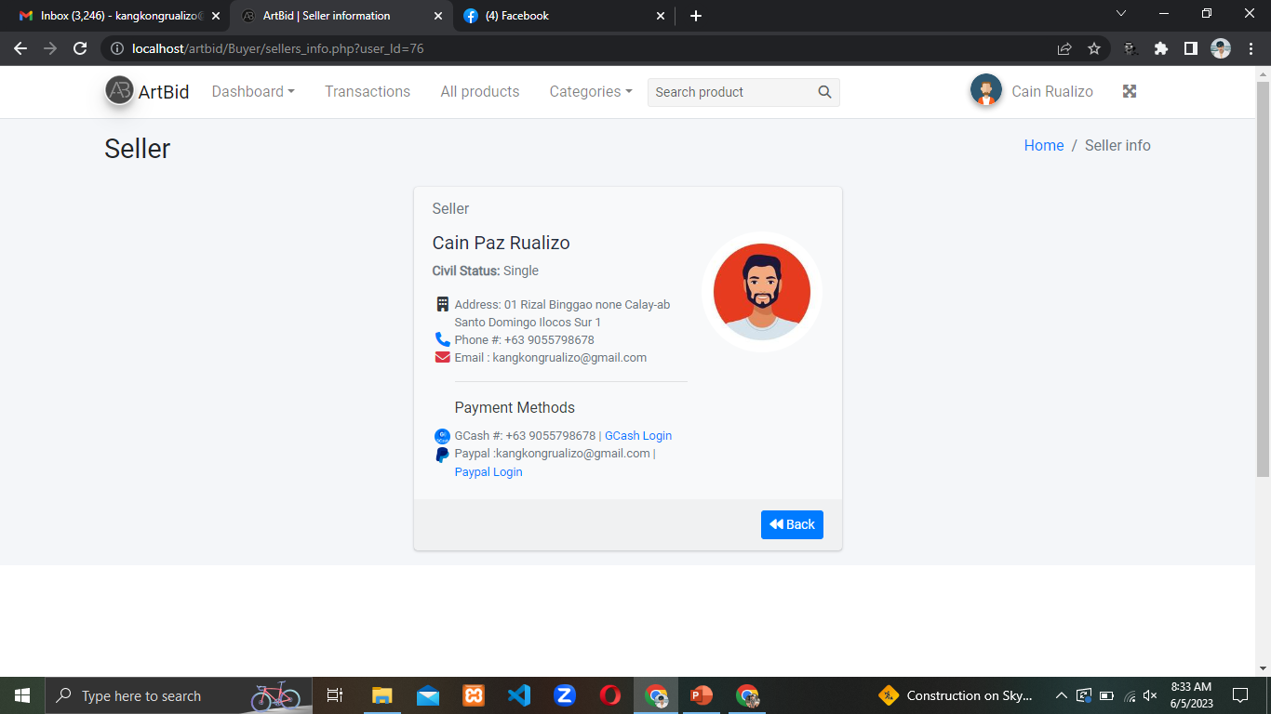
To see the sellers information just click in the sellers info in the item

Slide 35
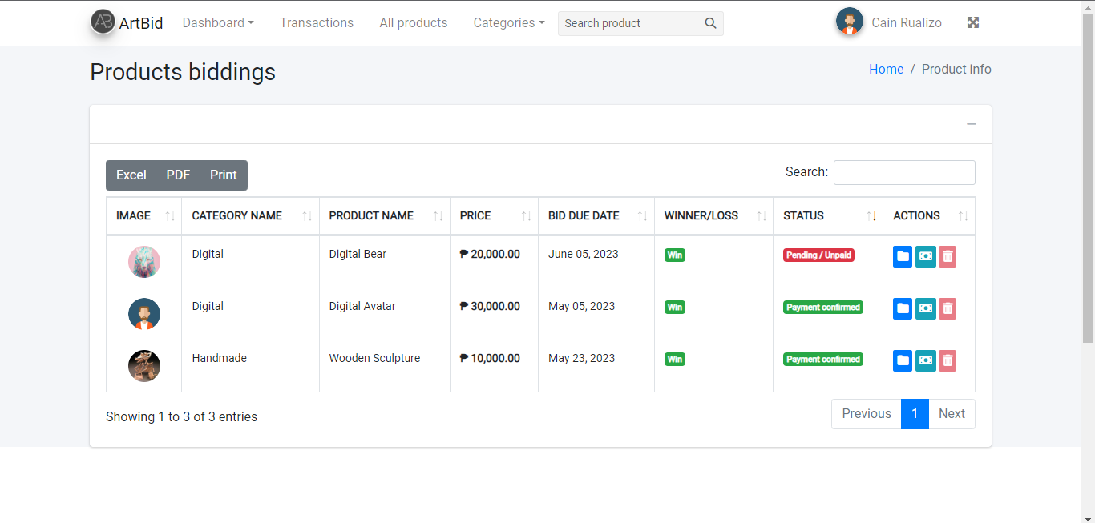
Once you pay for the product screenshot or capture the receipt and send it from the traction to complete the payment

Slide 36
Seller

Slide 37
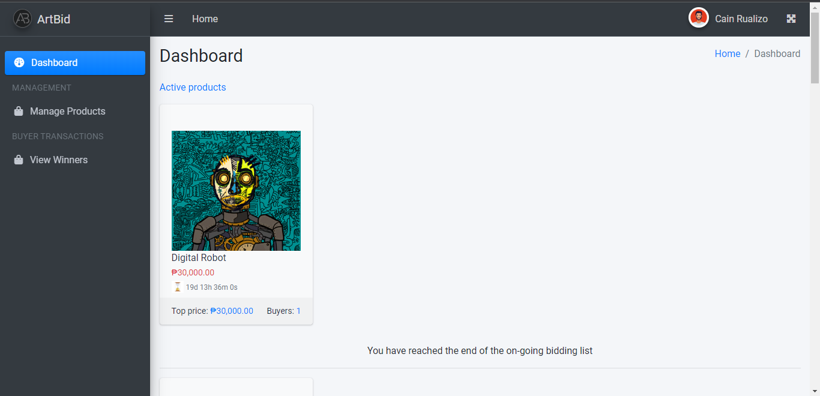
Sidebar: The dashboard shows the product active/available.

Slide 38
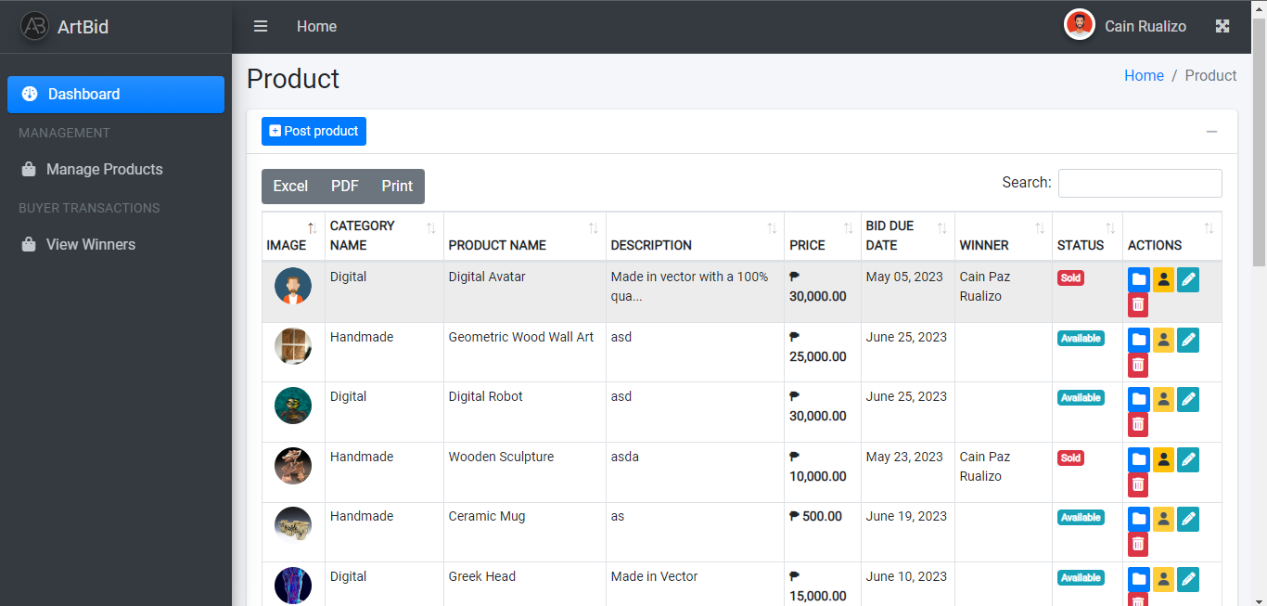
Sidebar: The manage product can add items for bidding and modify the item

Slide 39
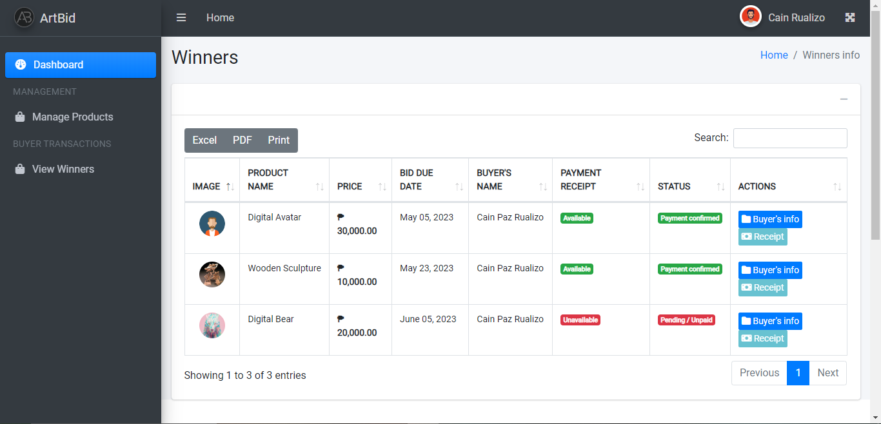
Sidebar: winners will show in the view winners, view the receipt and confirm the payment of the buyer

Slide 40
Admin

Slide 41
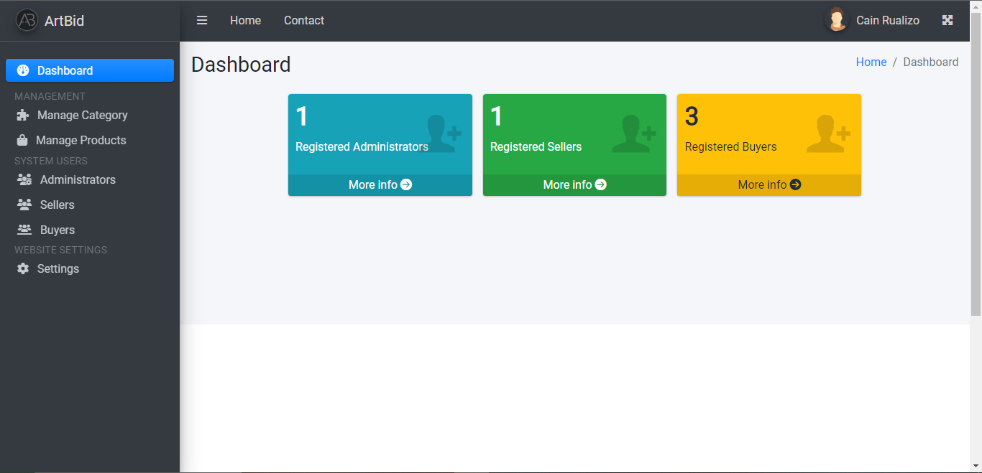
The dashboard shows the registered bidder and seller

Slide 42
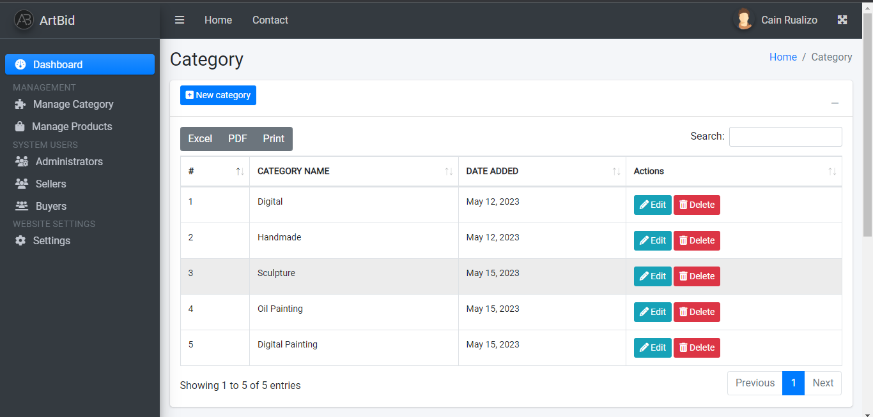
Sidebar: the manage category can add and modify categories

Slide 43
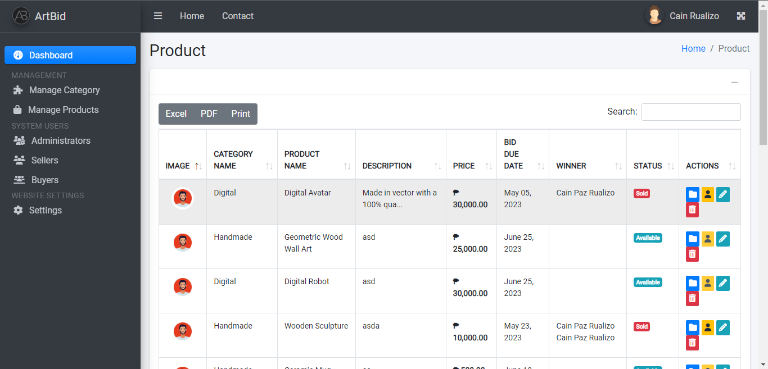
Sidebar: the manage product show the seller uploaded product and it can modify it

Slide 44
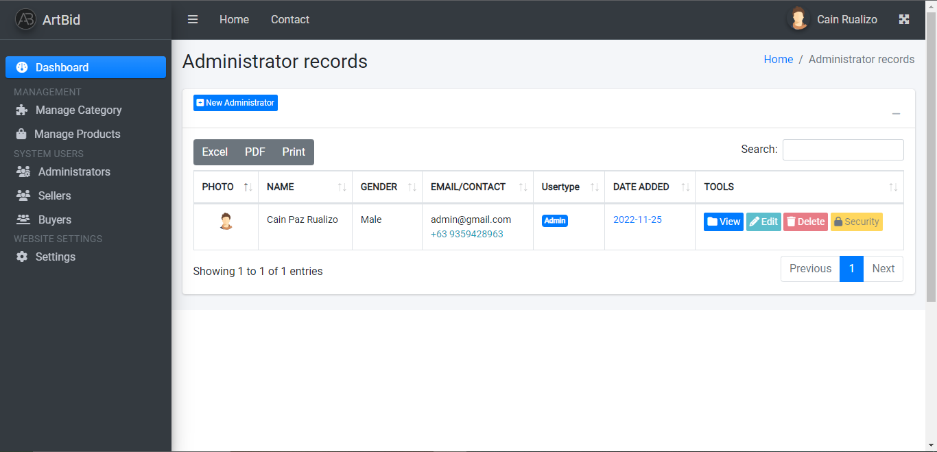
Sidebar: the administrator shows the registered admin and staff and it can add, view, edit, and delete.

Slide 45
Sidebar: the Sellers show the registered sellers and it can add, view, edit, and delete.

Slide 46
Sidebar: the buyers show the registered buyers and it can add, view, edit, and delete.

Slide 47
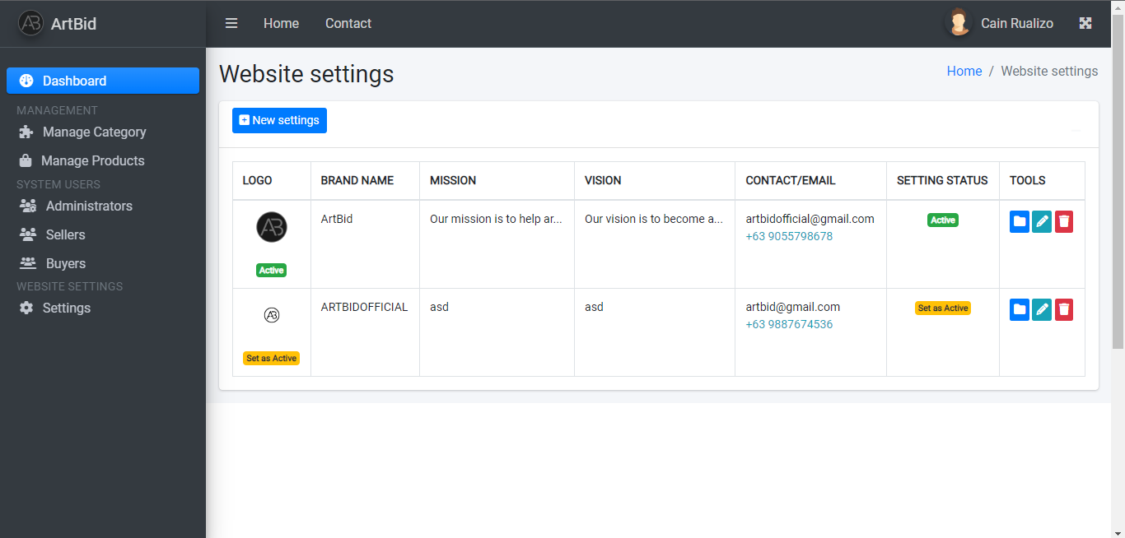
Sidebar: the settings can add, edit and delete the information of the website.

Slide 48
End of the slide Thank you!

